Slide 1
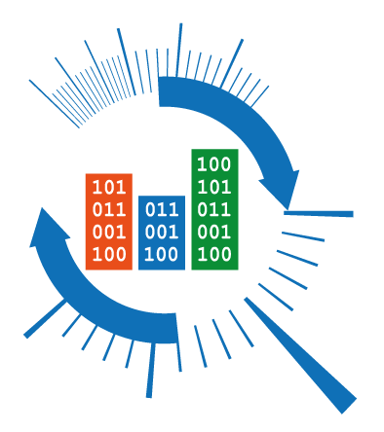
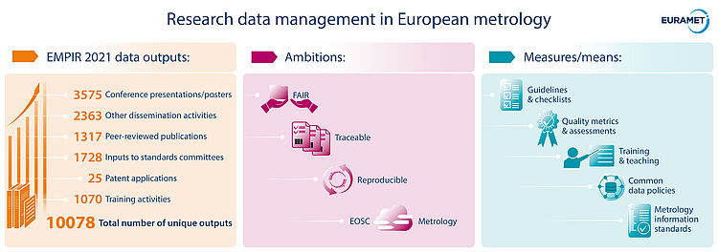

Data Management Policy Template
Policy Task Force of the TC-IM 1449 Project

Slide 2
Why a Policy?
Very short, "political" statement
The Policy should be followed by detailed, practical Guidelines for Research Data Management
A Policy is important because...
It shows the commitment of the NMI
It defines a direction to handle with data
It guarantees fulfilment of EC requirements (=> funding)

Slide 3
Structure
Two A4 pages, three sections:
Definitions
Guiding principles
Responsibilities, Duties, Rights
Basic principle:
"As open as possible, as closed as necessary"

Slide 4
Core requirements
Open the data lying behind published scientific articles on publicly funded projects.
Unless there are specific reasons against it.
Open data shall:
Be published in a repository conform to FAIR principles.
Own a license allowing nonlimited re-use (CC-BY, CC-BY-SA).
Have a permanent identifier (like DOI).
Be properly stored for at least 10 years.
Be citable

Slide 5
Responsibilities
Clear division of responsibilities between NMI and the affiliate.
In summary:
The affiliate (employee, post-doc, student, …) shall implement the Policy for his/her activity.
The NMI shall put the affiliate in the condition to do so (provide infrastructure, funding, guidelines, …)

Slide 6
Thanks for your attention!

